Slide 1
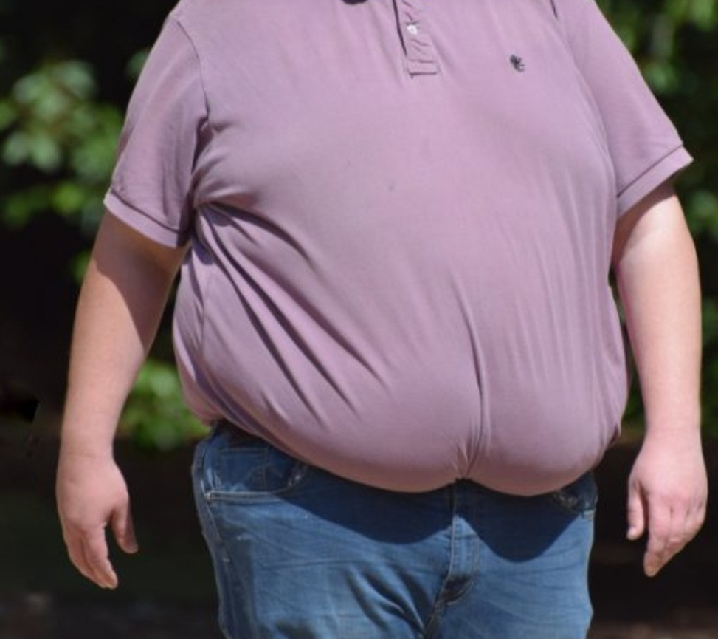
Obesity
Dr. Zainab A. Al-Mayyahi
Department of Medicine
College of Medicine
University of Basrah

Slide 2
Objectives
By the end of this lecture you should be able to:
Define obesity as a chronic heath problem
Understand the pathophysiology and causes of obesity
Describe the complications of obesity
Assess and classify overweight and obesity
Help to manage patients with overweight and obesity
Provide advices to prevent obesity

Slide 3
Obesity
Obesity is a chronic disease caused by excessive fat accumulation in the body usually due to imbalanced caloric intake that presents a risk to health
A daily extra 50–200 kcal would lead to weight gain of 2–20 kg over a period of 4–10 years.

Slide 4
Pathophysiology
The physiology of appetite and satiety is a complex highly regulated process controlled by several hormones that affect the hunger center in the hypothalamus
Hypothalamus
Lateral part controls hunger
Para ventricular nucleus controls satiety

Slide 5
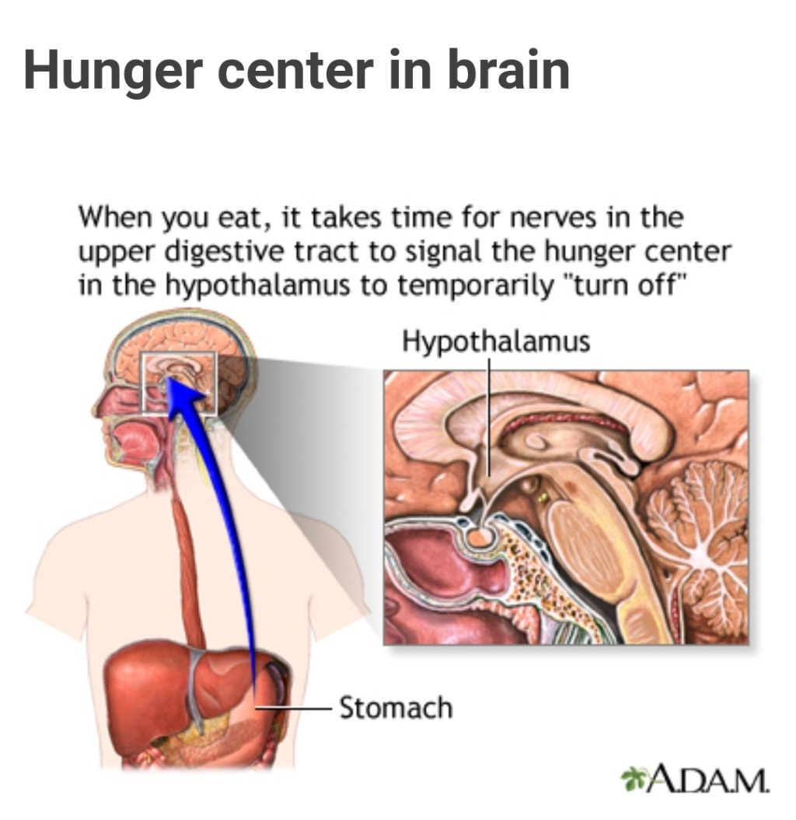

Slide 6
Pathophysiology
Ghrelin Produced in GIT in response to empty stomach increase hunger, by stimulation of the synthesis of Neuropeptide Y in the hypothalamus( orexigenic effect)
Cortisol (stress or emotional eating)
Growth hormone releasing peptide produced by gastric mucosa

Slide 7
Pathophysiology
Leptin Hormone produced by fat cells is potent inducer of satiety (anorexigenic) others include
Insulin
Adiponectin
Amylin from beta cells of the pancreas
Epinephrine (stress)

Slide 8
Pathophysiology
Cholecystokinin
Peptide YY
Pancreatic poly peptide PP
Somatostatin
Incretins enhance glucose-stimulated insulin secretion Glucagon like peptide 1( GLP-1) Secreted by intestinal mucosa
Enterostatin

Slide 9
Causes of obesity
increased energy intake
Overeating
Frequent snacking
Imbalanced meals
Psychological and social factors
Alcoholism
Wealth

Slide 10
decreased energy expenditure
Decreased BMR (hypothyroidism)
Physical inactivity
Sedentary life style
Increased energy storage

Slide 11
Other causes of obesity
Genetic causes
Endocrine hypothyroidism, Cushing s disease , Polycystic ovarian syndrome insulinoma
Hypothalamic diseases (trauma, tumor)
Drugs corticosteroids, antidepressant, sulphonylurea, insulin , anticonvalcents
β-blockers

Slide 12
Clinical features of obesity
Patients usually present with wait gain and its complications that can effect all body systems
The most serous is increased cardiovascular and malignancy risks which leads to poor quality of life and deceased life expectancy

Slide 13
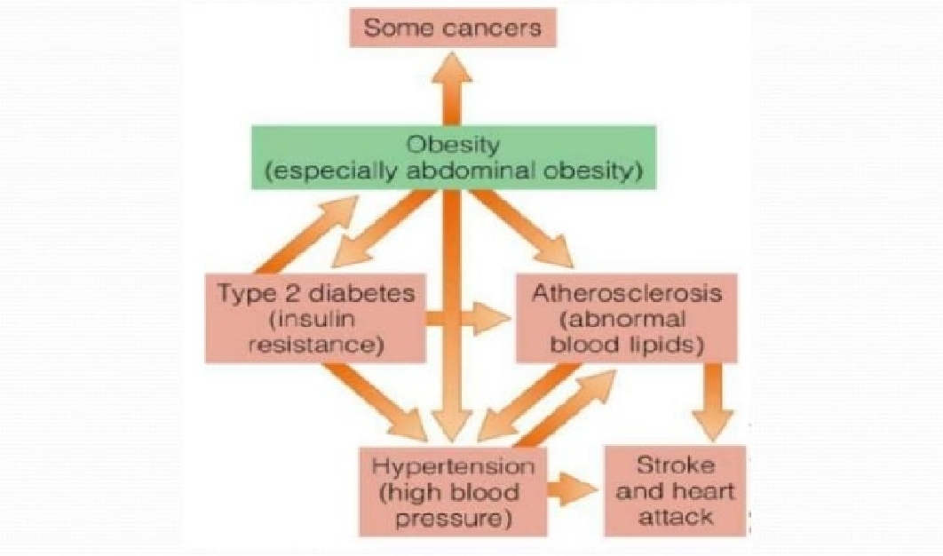

Slide 14
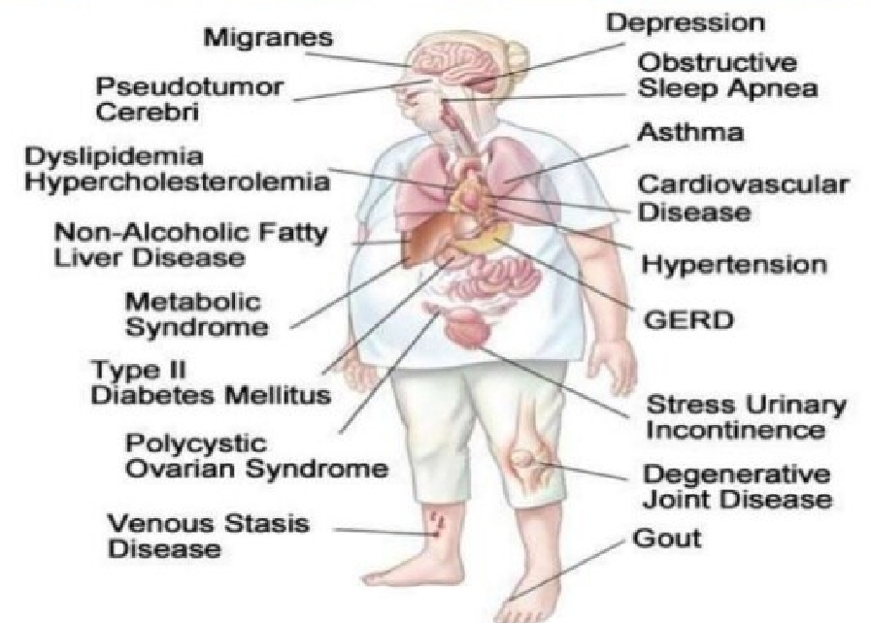
Clinical features of obesity

Slide 15
Other complications of obesity
Glomerulonephritis
Increased risk of pulmonary embolism
Gall stones
Infertility
Increased risk of pregnancy complications
Carpal tunnel syndrome
Skin diseases Striae, Acanthosis nigricans ,Hidradenitis ,Intertrigo, excessive sweating
Dementia

Slide 16
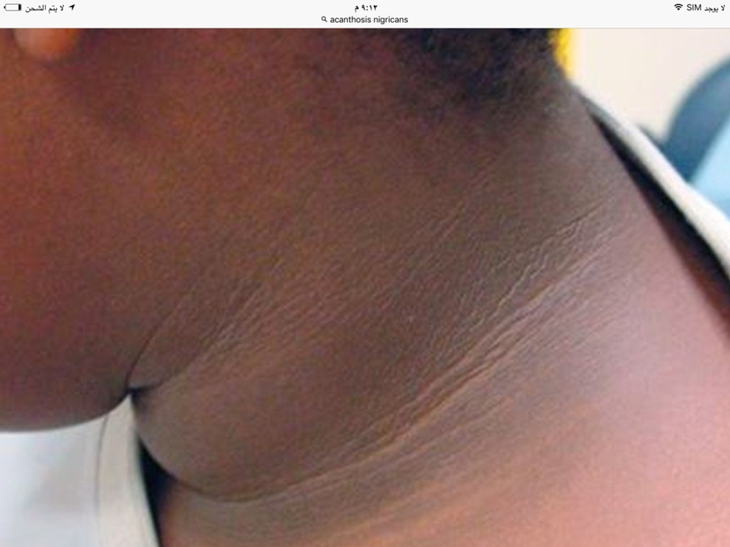

Slide 17
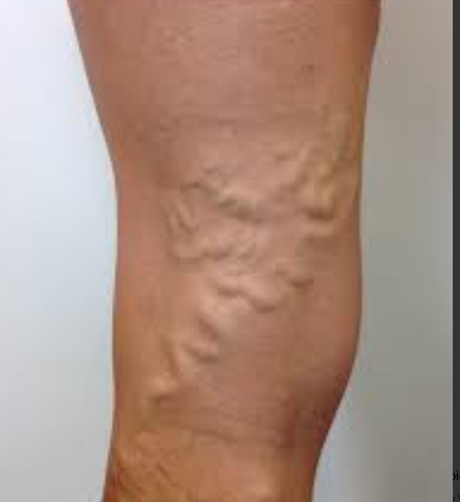

Slide 18
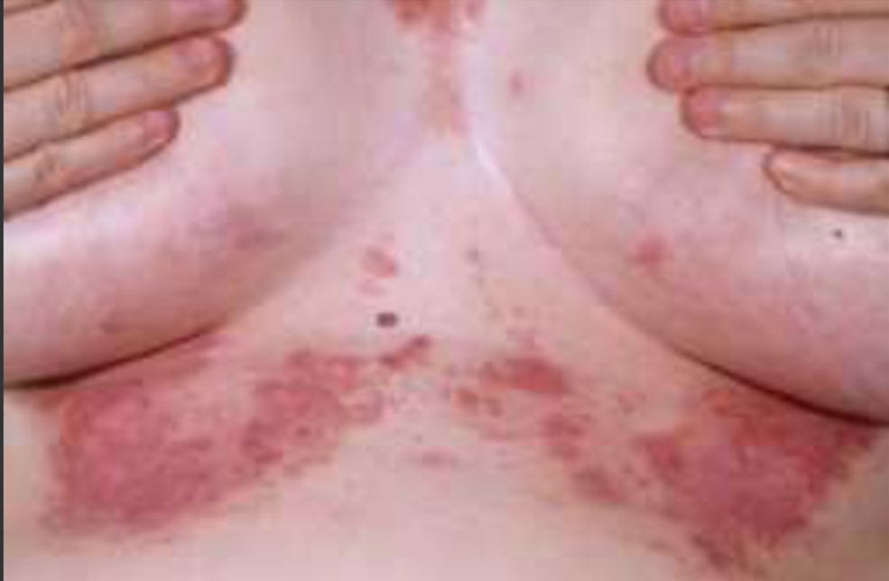

Slide 19
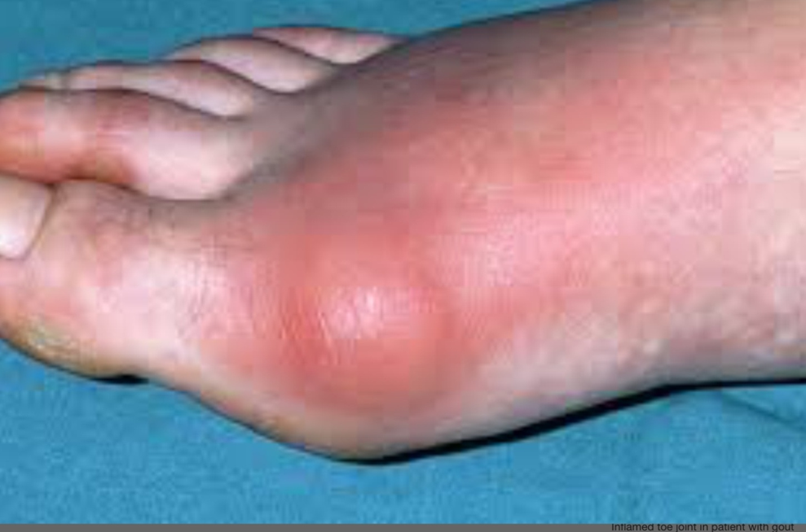

Slide 20
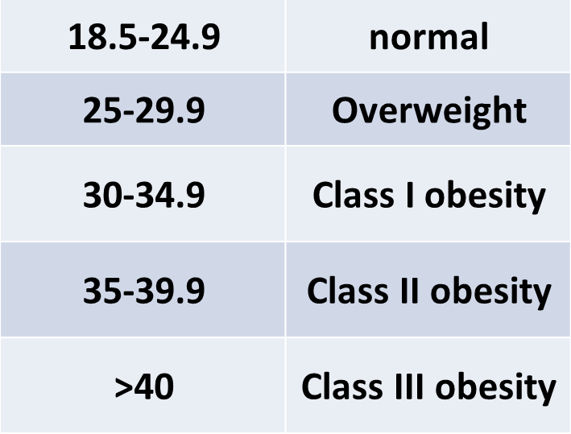
Clinical assessment (BMI)

Slide 21
Clinical assessment waist circumference
BMI cannot describe precisely the distribution of body fat.
Excess abdominal fat ( central obesity) has stronger association with hypertension, DM2 and IHD
waist circumference
102 cm in man
82 cm in woman

Slide 22
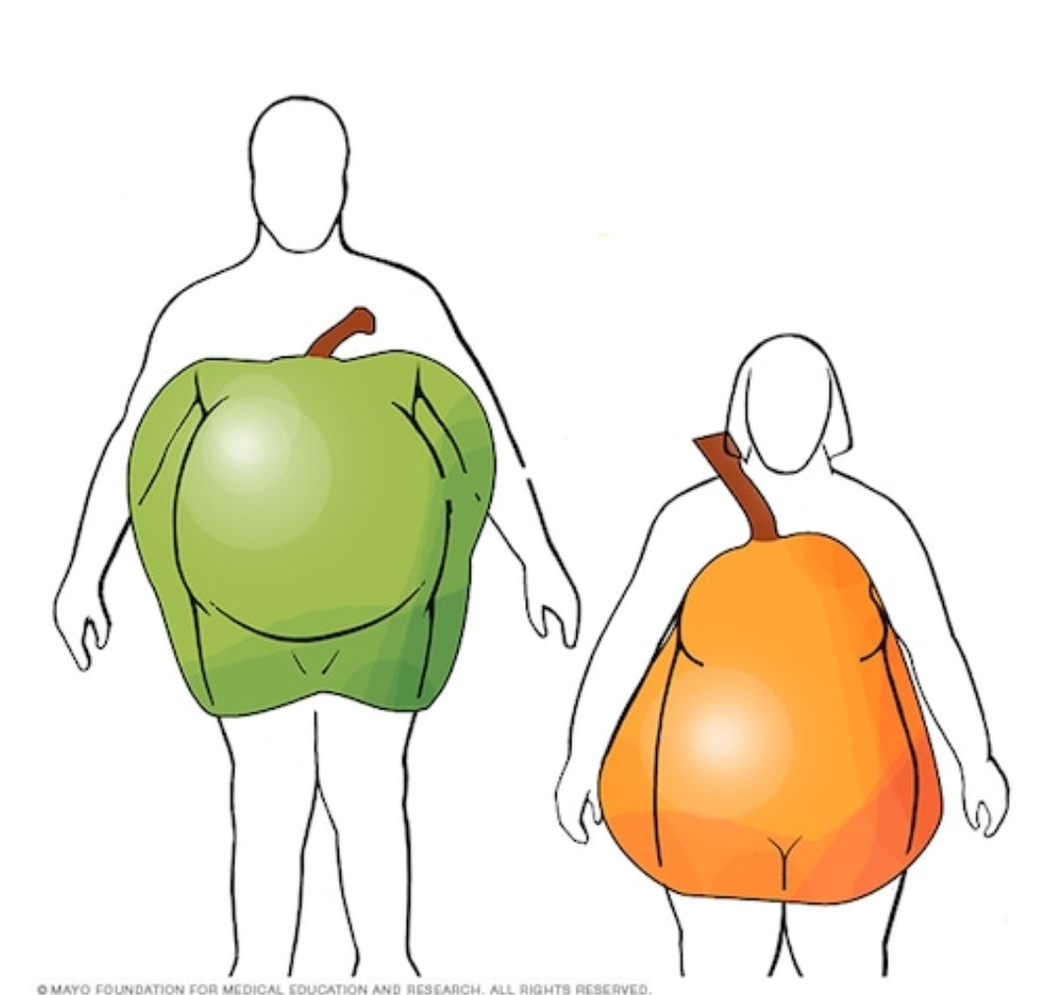
Clinical assessment waist circumference

Slide 23
Clinical assessment waist /hip circumference ratio (WHR)
A more sensitive index to determine the fat distribution
> 1 in man
>0.9 in woman
These figurers is associated with higher mortality & morbidity

Slide 24
Clinical assessment triceps skin fold thickness (mm)
20 mm in man
30 mm in woman
measured in middle of triceps muscle

Slide 25
Investigations
Mainly for possible causes and complications of obesity
TFT
24 hours urine free cortisol
Serum glucose HB A1C
Lipid profile
ECG ,ECHO
Abdominal ultrasound

Slide 26
Management of obesity
Weight reduction is the main step in treatment
Treatment of obesity complications like DM, HTN, IHD etc..

Slide 27
Management of obesity
10 % redaction in weight will leads to
20-25% reduction in mortality
Reduce risk of development of DM by 50%
10% fall in TC
10 mm Hg reduction in systolic & diastolic BP

Slide 28
Management of obesity
Non pharmacologic behavioral modifications( diet ,Exercise and life style changes)
Pharmacologic treatment (anti obesity drugs
Bariatric surgery

Slide 29
Non pharmacologic behavioral modifications (Exercise)
This should be in conjugation with dietary therapy
Better under physical therapist supervision
45 to 60 mins of moderate intensity physical activity a day for at least 5 days /week (225 to 300 mins /week) or lesser amounts of vigorous physical intensity /week is required
Walking ,cycling or swimming
Should be started gradually to prevent muscle soreness and fatigue

Slide 30
Non pharmacologic behavioral modifications (Life style changes)
Improve sleep quality
Walking vs. driving
Stairs vs. elevators
Avoid sitting for long time ( TV watching , gaming)
Avoid prolong use of smart phones, tablets, computers
Increase outdoor activities and hobbies

Slide 31
Non pharmacologic behavioral modifications (diet)
Dietitian consultation is required
Low caloric diet is requires ( 1000 kcal/day), Aim is to decrease 0.5 kg/week
Sugar and calorie dense food should be avoided
Small portion size meals
Small plate
Slow eating
Avoidance of snacking
Very high protein diet is discoursed
Starvation diets is not required

Slide 32
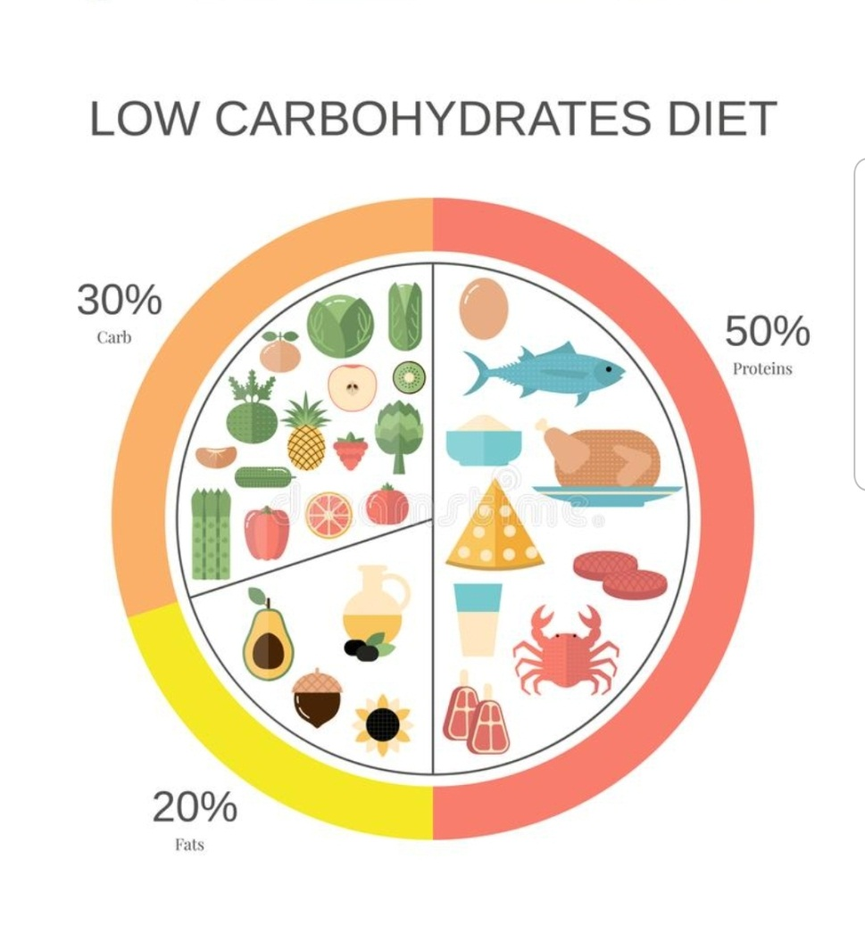

Slide 33
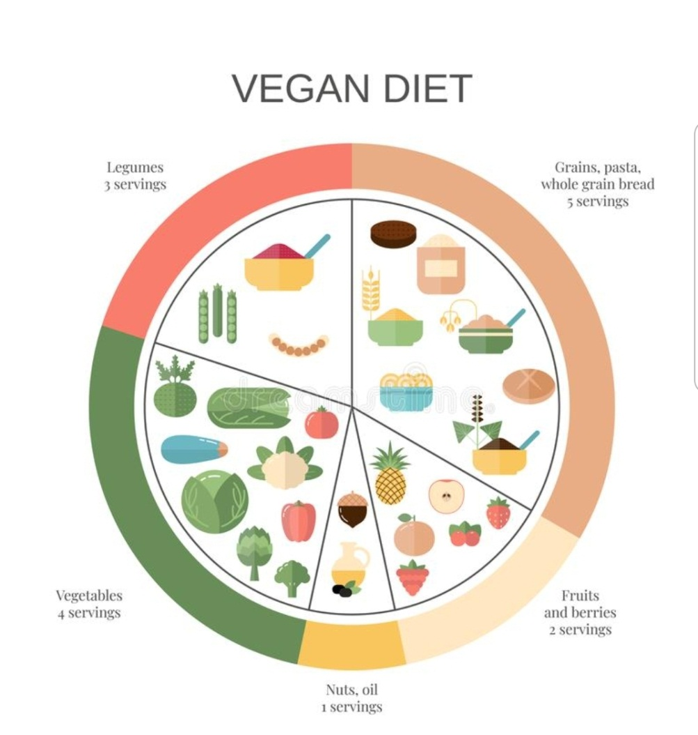

Slide 34
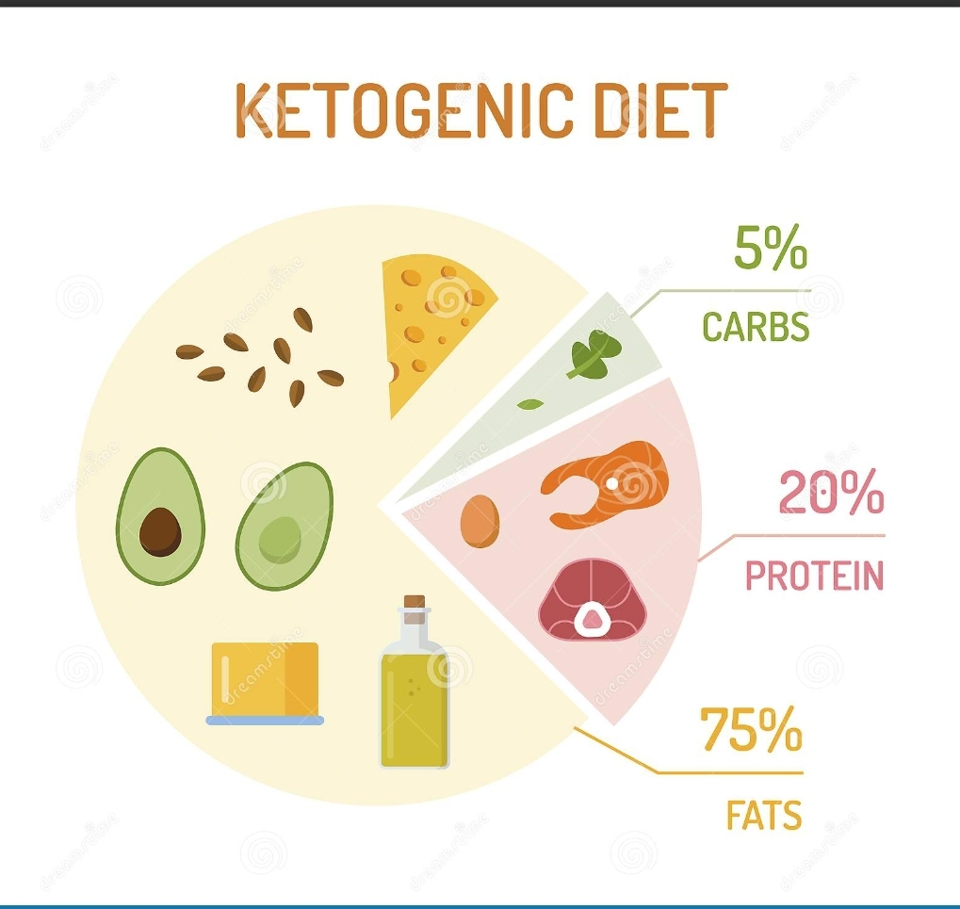

Slide 35
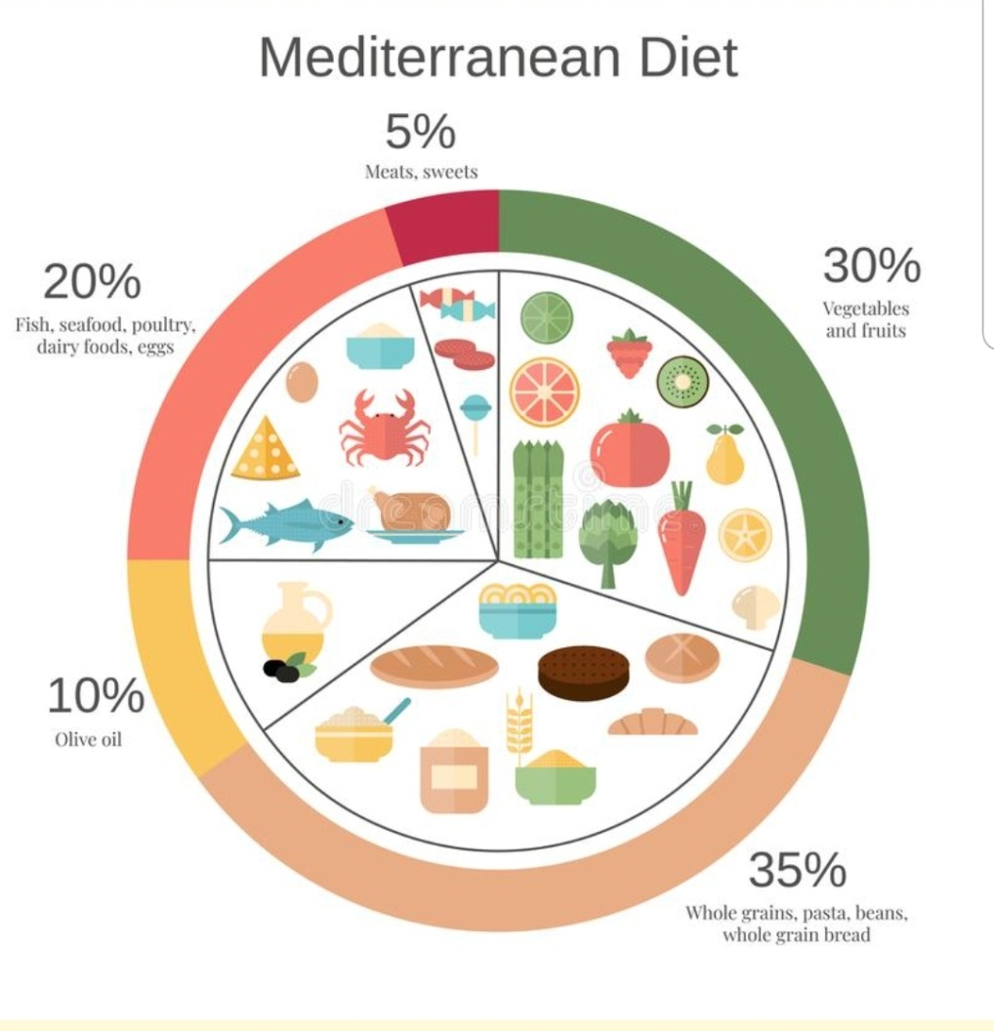

Slide 36
Pharmacologic treatment (anti obesity drugs
Orlistat (Xenical)
Oral
Inhibit pancreatic lipase
30% reduction of dietary fat absorption
120 mg 3 times daily with meal for 3 months
S E ,fatty stool , diarrheas ,fecal urgency , Fat soluble vitamin deficiency

Slide 37
Pharmacologic treatment (anti obesity drugs
Glucagon like peptide 1(GLP-1) agonists
Injectable
Liraglutide ( daily)
Semaglutide ( weekly)
suppresses appetite and delayed gastric emptying
Helps in control DM2
SE nausea, vomiting, dyspepsia

Slide 38
Bariatric surgery
Indications
Sever ( morbid) obesity BMI>40 kg/m2
BMI 35kg/m2 with significant Co morbidities
The mechanism of reducing weight is not entirely due to reduction of absorptive capacity , it may be due to Disturb release of ghrelin from stomach and increased release of peptides from intestine which enhance satiety

Slide 39
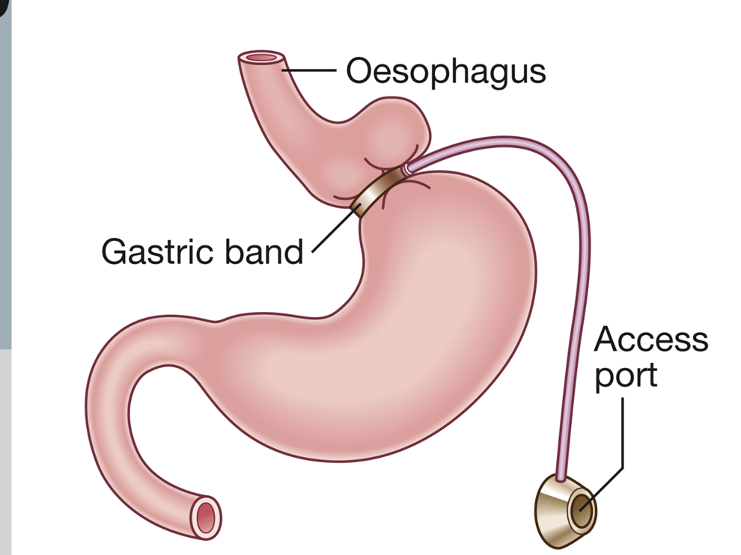
Gastric banding

Slide 40
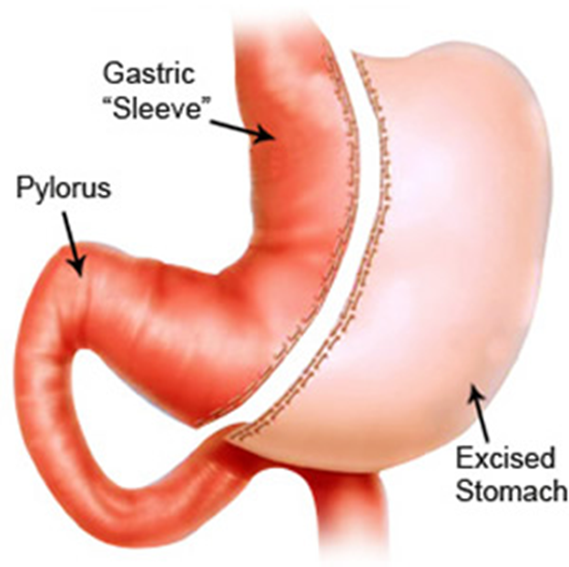
Sleeve gastrectomy

Slide 41
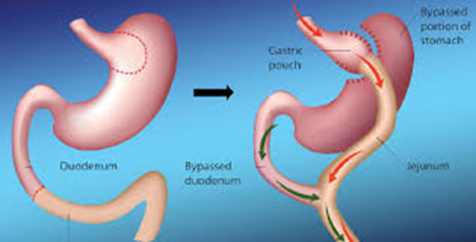
Gastric bypass surgery

Slide 42
Complications of surgery
0.2% mortality
Complication of general anesthesia
GERD
Erosions
Stricture
B12 deficiency
Iron deficiency
Regain of weight can occur

Slide 43
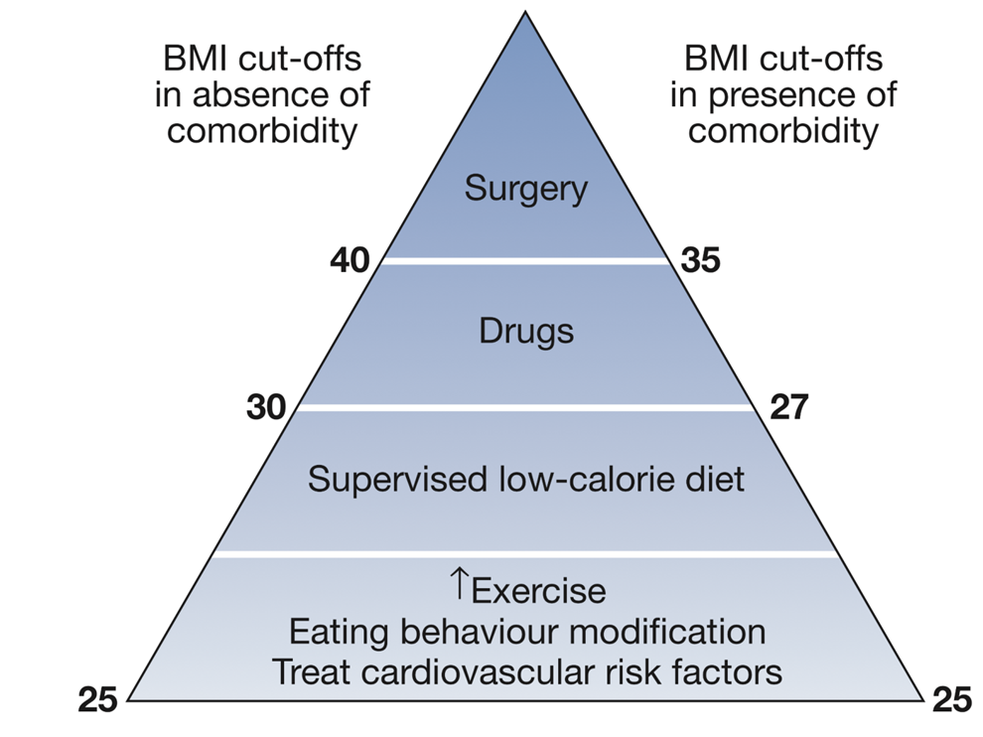

Slide 44
Prevention
It is much more easier to prevent than to treat obesity and its complications
Prevention incudes advice about healthy life styles and encouraging regular exercise

Slide 45
Summary
Obesity is a worldwide epidemic that affect 40% of adults in the united states with a lot of physical and psychological complications
Excess caloric intake and physical inactivity is the main causes
Weight gain and its complications ( DM, HTN.IHD) are the most common presentation
Treatment is mainly by diet and exercise
Morbid obesity may need surgical treatment

